Slide 1



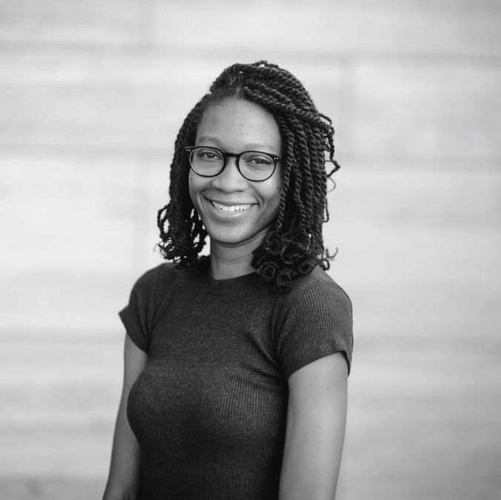
Akua Nyame-Mensah – Associate
Professional experience
Education and skills
Africa Foresight Group
Built focus initiatives in the African healthcare and education sectors
Built an Investor Deck on Healthcare Businesses in Nigeria
Talent search to occupy the role of a General Manager of an Agribusiness
Development and consolidation of the GIZ SEDEC Cluster in Nigeria (including strategy development, workshop facilitation, stakeholder engagement and advise to projects in the cluster)
4 years at Jumia (formerly African Internet Group) where her work focused on launching and growing classifieds platforms in Ghana and Nigeria. Over the 4 years Akua has:
Launched and built Ghana’s largest online real estate portal
Established, developed and maintained relationships with major real estate developers and agents, media and other technology company executives
Recruited; provided leadership, coached, and managed sales/aftersales, marketing/ communications/social media, business development and customer service teams
Supported sales targets and platform KPIs by conceptualizing, managing and editing company internal and external communications content including sale pitches, journal posts, reports, and email newsletters and campaigns
Akua holds a Masters in City Planning from the University of Pennsylvania
She is currently pursuing an MBA at the African Leadership University and a professional coaching certification
She also holds a bachelor’s degree from Bryn Mawr College in Growth and Structure of Cities
More information about Akua’s educational background and experience can be found on her online portfolio.
Introduction
Akua is an interdisciplinary leader with emerging market experience launching and building online businesses. She has a proven track record to successfully develop talent, engage with different stakeholders and build partnerships, processes and communication strategies to exceed organizational goals. Akua is obsessed with technology and its ability to positively transform lives, spaces and make organizations more sustainable and profitable.

